Slide 1

Data engineer salary analysis
By Fatima Shamilova

Slide 2

Introduction
We selected the Data Engineer Salary dataset in 2024 for our group project.
Data engineering is a promising career choice in 2024, with high demand and lucrative salary prospects. To become a data engineer, strong programming, and database management skills, as well as knowledge of data warehousing and visualization, are essential.
On this project we will analyze the Data Engineer/Analyst Salary dataset using one of the Python IDE from Kaggle.com.

Slide 3

The Python IDE selection
The Jupyter Notebook (Python3) has been used to analyze Data Engineer Salary dataset.

Slide 4
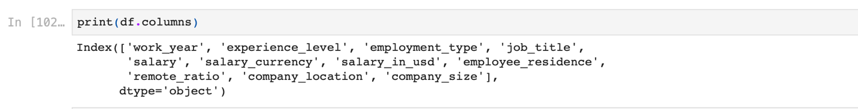
The dataset analysis and summary
This image displays the first rows’ values of the dataset such as work_year, experience_level, employment type, job_title, salary, salary_currency, salary in USD, employee_residence, remote_ration, company_locations, comoany size.

Slide 5
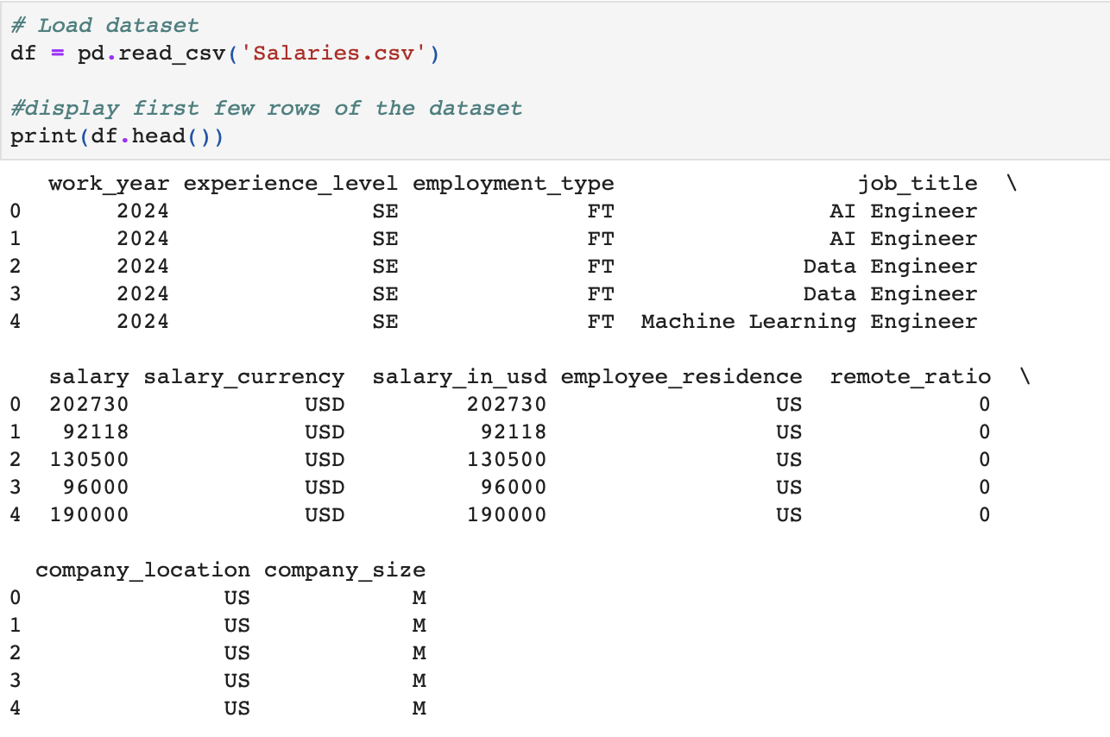
The dataset analysis and summary

Slide 6
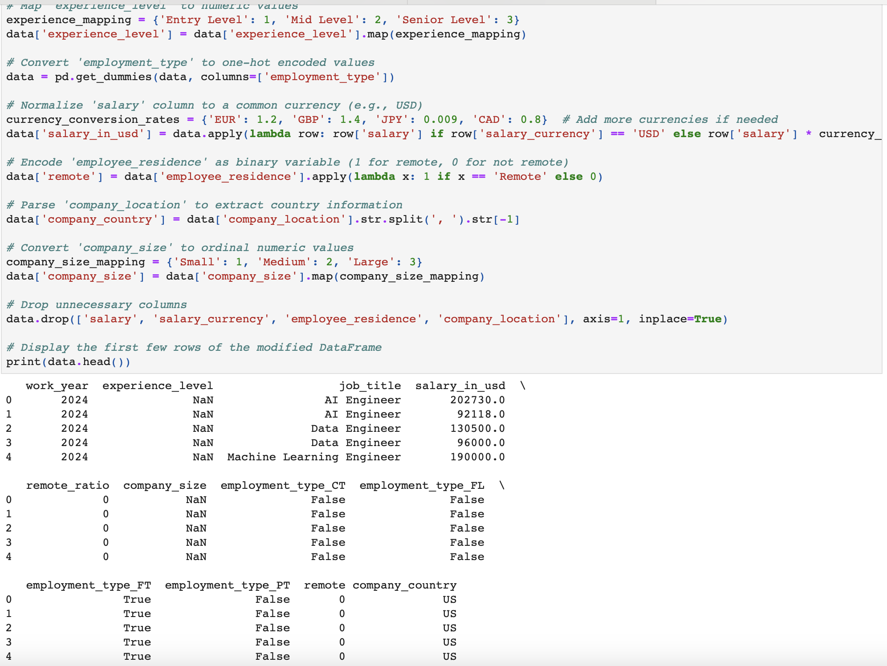
This is the result of the data modification in this version by printing the first few rows of the updated Data Frame using the print statement at the end. For particular needs, modify the print statement or any other section of the code as necessary.

Slide 7
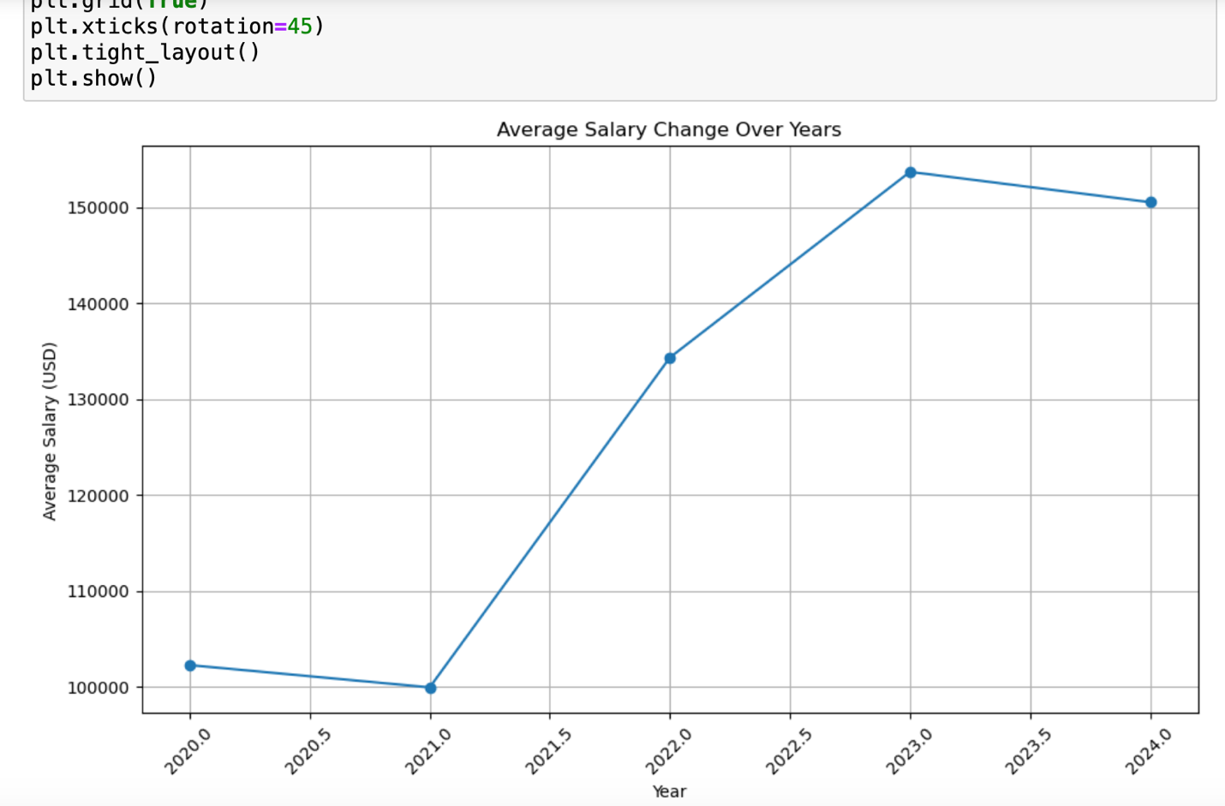
This line chart illustrates the changes in average salary over the years from 2020 to 2024. It indicates a consistent increase in average salary for Data Engineers up until the mid-year of 2023. However, starting from the mid-2023, there is a noticeable decline in the average salary, signifying a reversal in the previous upward trend.

Slide 8
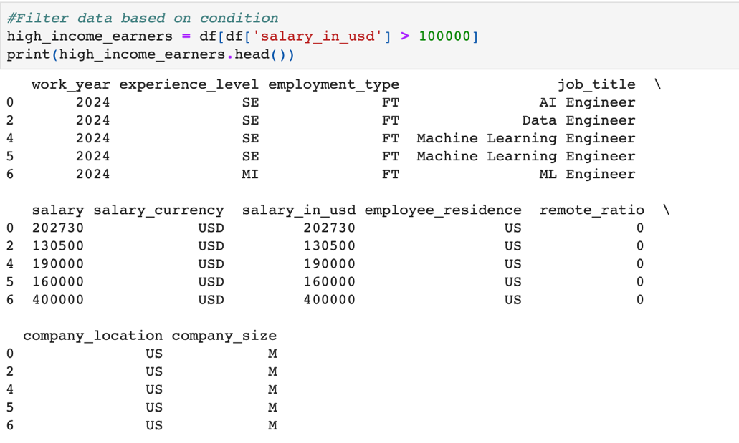
Filter data based on condition
The filtered DataFrame contains a total of 16534 individuals who have an annual salary exceeding $100,000 USD. Most high-income earners belong to the Senior (SE) or Mid (MI) experience levels, indicating that individuals with higher levels of experience tend to earn higher salaries. The majority of high-income earners are employed in full-time positions, suggesting that full-time employment is associated with higher salaries. High-income earners hold various job titles such as AI Engineer, Data Engineer, and Machine Learning Engineer. Most high-income earners are located in the United States, as indicated by the 'employee_residence' and 'company_location' columns.

Slide 9
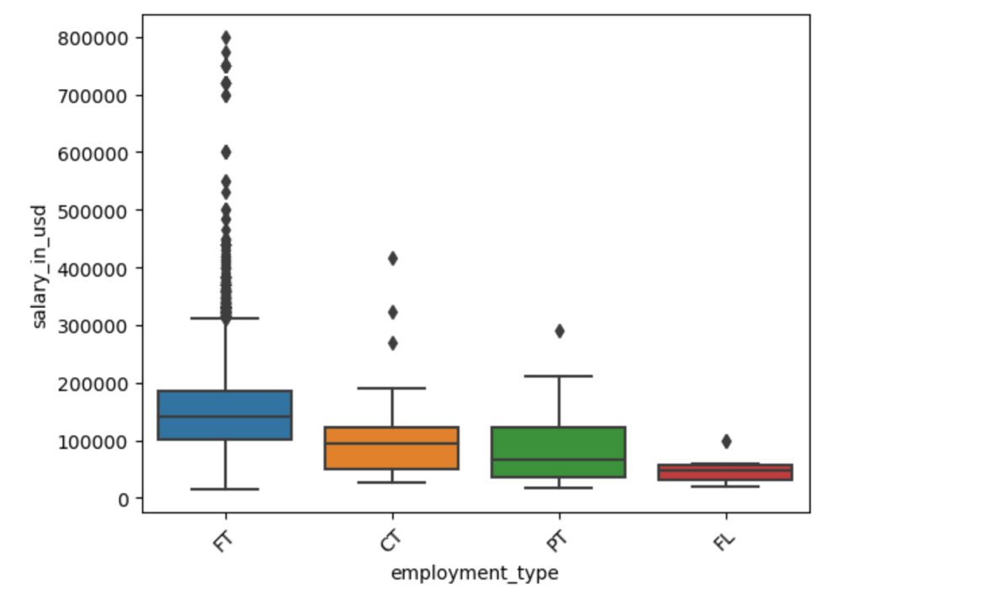
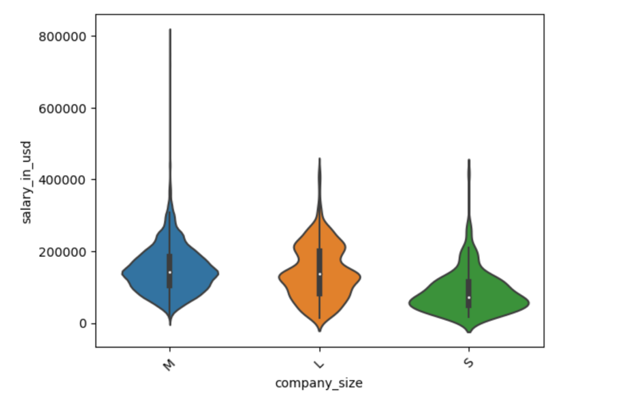
Salary distribution across different employment types Salary distribution across different company sizes
These visualizations provide insights into how salary levels vary across different employment types and company sizes, offering valuable information for job seekers and employers alike.

Slide 10
Conclusion
In this project, we analyzed the Data Engineer Salary dataset using Python. We conducted an analysis of the dataset's characteristics, including the distribution of salary across different factors such as company size, job title, and company location. Visualizations such as boxplots and violin plots were employed to explore these relationships.
Furthermore, we conducted a thorough check for missing values in the dataset to ensure data completeness. Fortunately, no missing values were found, which facilitated a smoother analysis process.

Slide 11

References
Kaggle.com. Data Engineer Salary dataset in 2024
Python3
Eric Matthes. Python Crash Course: A Hands-On, Project-Based Introduction to Programming. November 2015.

